Slide 1
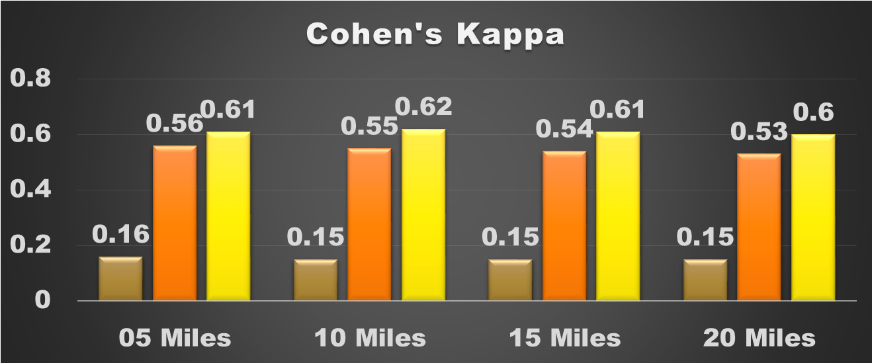
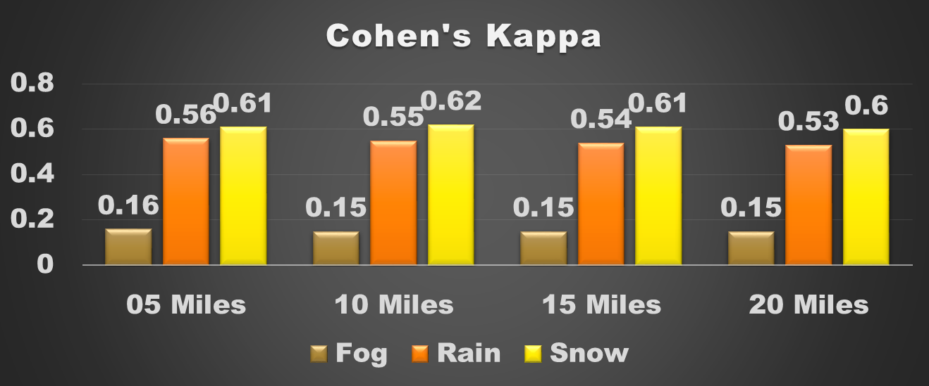
The Viability of Land-Based Weather Station Data On Highways: National-level and Regional-level Analysis
Objective
This study aims to assess the viability of NOAA’s Quality Controlled Local Climatological Data (QCLCD), which include all data related to all land-based weather stations: AWOS (Automated Weather Observing System), MAPSO, Navy METAR, ASOS (Automated Surface Observing System), CRN (Climate Reference Network) and so on, as direct weather information for highways.
Data Sources
  Nationwide QCLCD between May 2007 and December 2014 form NCDC
  Nationwide fatal crashes between 2007 and 2014 from the FARS
  Nationwide AADT of the Highway Performance Monitoring System (HPMS) in 2011 and 2012
n*n Contingency Table Analysis between QCLCD and FARS
Cohen’s Kappa: The measurement of observer agreement for categorical data which can be used as a measure of the reliability of multiple determinations on the same subjects
  Overall, QCLCD and FARS’ weather records have a moderate agreement (0.41-0.60) up to 20 miles. However, cases of fog weather have a slight agreement (0.00-0.20).

Slide 2
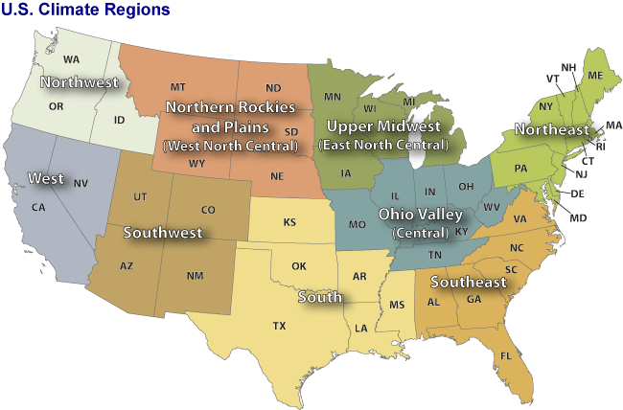
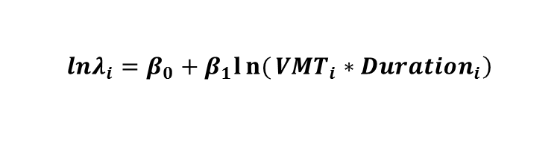
Statistical Modeling with Weather/Traffic Exposure Variables
To analyze the regional applicability of QCLCD, the Negative Binomial regression model was used.
The first type of models relates total fatal crashes under specific weather conditions to the annual total length of the corresponding weather.
USA Climate Regions
R+, F-
R+, S-
R+, S-
R+, S-
$$\left.lnλ_{i}=β_{0}+β_{1}ln{(}{VMT}_{i}∗{Duration}_{i}\right)$$
  For most regions, the increase of VMT during specific weather duration has a significant positive relationship with weather-related fatal crashes.
R-, S-, F+
F-
R+, S-
S-
  The second type of models shows the relationship between annual total fatal crashes and duration of each weather condition.
$$lnλ_{i}=β_{0}+ β_{1}ln{VMT}_{i}+β_{2}{Rain}_{i}+β_{3}{Snow}_{i}+β_{4}{Fog}_{i}$$
Conclusions
The QCLCD can be used to manage the weather-related traffic safety for highways because QCLCD has a moderate agreement with FARS’ weather records even without any forecasting.
According to the statistical models by climate region, the QCLCD can be a good exposure measure for weather-related traffic crashes.

